Slide 1


SOFTWARE TO SUPPORT THE ACTIVITIES OF THE REGISTRATION CLERK AT “FUTURE ROCK STARS” (FURS) Software Development Project IST 303 FALL 2017
Yu Kao
Imad Fahim
Yaser Alhasawi
Christoffer Gamborg

Slide 2
Outline
Requirements
User Stories
Estimations
Velocity
Milestone 1.0/Iteration
Big Board
Demonstration

Slide 3
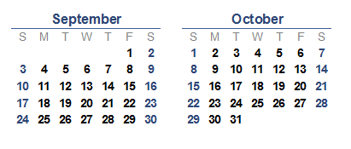


Group meeting
Milestone 1.0 due date
Group and customer meeting
Start day
Notes:
Meeting: twice a week (Tuesday, Saturday) with customer on Tuesday every 2 weeks

Slide 4



Requirements
customer statement
listed all the functions needed
divided to small user stories
Notes:
Started with a problem statement from the customer.
Customer has listed all the functions needed.
The function then were identified by the team and divided to small user stories
The user stories were presented to the customer to eliminate any assumption and to ask more question regarding the requirements.
Customer were asked to prioritize the functions for the Milestone 1.0 .

Slide 5
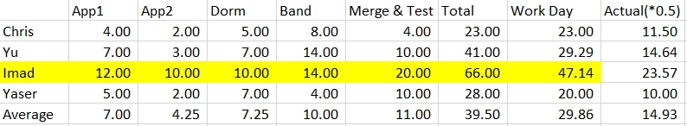
User Stories/Task Estimation
Notes:
Why did we do this: To calculated the amount of time we should actually use.

Slide 6
Velocity
4(team)× 5 (working days) × 0.5 (first velocity) = 10 (days/week) 10 (amount of work in person days) × 6 (number of weeks) = 60 (days/milestone)
60(person-days/milestone) - 30(plan-poker estimation) = 30
Notes:
Iteration work capacity: person-days/iteration Milestone work capacity: person-days/milestone

Slide 7
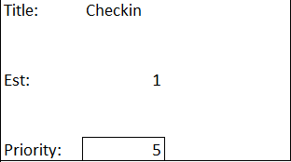
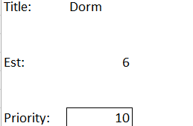
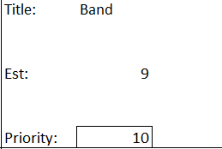
Milestone 1.0/ Iterations
Title: Refactoring 1
Est:
Priority: 7
Title: Refactoring 1
Est:
Priority: 7
Iteration 1
Total Days: 10
Iteration 2
Total Days: 15
Notes:
Iterations: (1 - 10) Low to High 1. Fill in the data(10), Edit the Instrument and talent(5),Check-in(5) 2Weeks
2. Dorm assign(10), Band Assign(10), 3Weeks
3. Merging all the part(8), test the software(8) Weeks

Slide 8
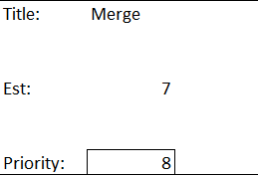
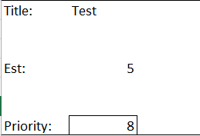
Milestone 1.0/ Iterations(cont.)
Iteration 3
Total Days: 12
Notes:
3. Merging all the part(8), test the software(8) 2Weeks

Slide 9
Milestone 1.0/ Iterations(cont.)
Requirements
Design
Code
Test

Slide 10


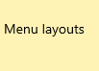
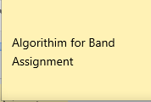

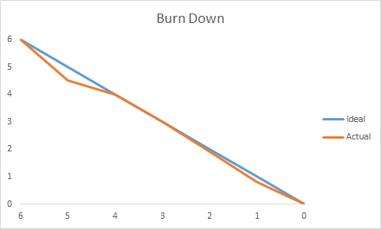
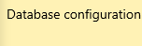
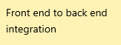
User Stories | In Progress | Complete | Burn Down

Slide 11
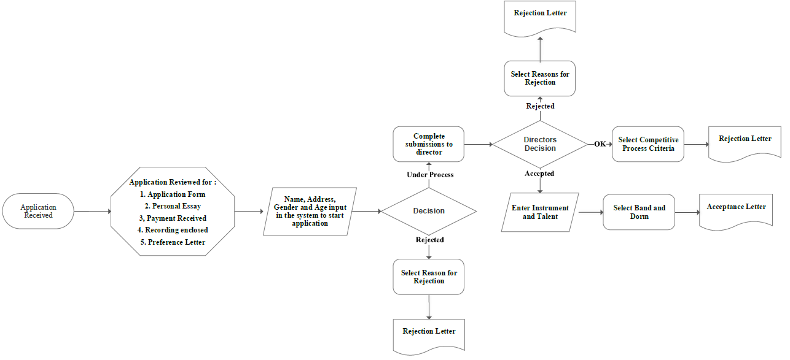
Flow Chart

Slide 12











User Stories
App1
App2
Check in
Notes:
App1: Clerk fills in the basic information from the applicant's (Id, FirstName, LastName, Adress, Gender, Age, Date, Camp, Essay, Payment, Recording, Status )
App2: Fill in talent, registration status, instrument
Check in: Clerk searches for students and if everything is OK they are checked in. Or asked to leave if not.

Slide 13


User Stories
Band Assignment Required function
Dorm assignment
Required function
Applicant: ID, Date, Camp, Name, Gender, Age, Essay, Payment, Recording, Decision, Dorm, Band, Talent, Instrument, Checked.
Notes:
Band Assignment: Assign band to each applicant's Check the number of applicants in each band
Check the gender
Check the talent
Check the instrument
Assign band to applicant
Build band back up list Dorm assignment: Assign dorm to each applicant's
Required function: Check the number of applicants in each dorm
Check the gender
Check the age
Assign dorm to applicant
Build dorm back up list
Applicant: ID, Date, Camp, Name, Gender, Age, Essay, Payment, Recording, Decision, Dorm, Band, Talent, Instrument.

Slide 14
Demonstration

Slide 15



